Slide 1
What’s Cooking?
Sarah Kruger
Notes:
#Load in the data.
library(jsonlite)
train<-fromJSON("C:\\Users\\krugers\\Documents\\PERSONAL\\BANA 6660\\Project 2\\train.json",flatten=TRUE)
#Split data into test and training.
set.seed(1)
trainset = sample(1:nrow(train), nrow(train)/2)
training = train[trainset,]
validation = train[-trainset,]
#Make a frequency table of each cuisine type.
diff_cuisines<-unique(train$cuisine)
ftable<-table(train$cuisine)
ftable<- sort(ftable, decreasing=TRUE)
par(las=3)
barplot(ftable, main="Types of Cuisine", xlab="Cuisine", ylab="Frequency", cex.names = .7)
#Find top 5 unique ingredients for each cuisine.
library(tm)
#Put into TM Function
SimpleIngredients<-Corpus(VectorSource(training$ingredients))
#Stemming to simplfy ingredients
SimpleIngredients <- tm_map(SimpleIngredients, stemDocument, language="english")
inspect(SimpleIngredients)
DTM<-DocumentTermMatrix(SimpleIngredients)
inspect(DTM[1:5,1:20])
FrequencyIngredients<- colSums(as.matrix(DTM))
length(FrequencyIngredients)
head(FrequencyIngredients)
OrderedFrequencyIngredients<-order(FrequencyIngredients,decreasing=TRUE)
TopIngredients<- FrequencyIngredients[OrderedFrequencyIngredients]
TopIngredients[1:10]
#Create function to run 10 ingredients
Top10Ing <- function(training, CuisineName){
#Create function to be able to tie it to cuisine type. Takes each cusine to work out top 10 ingrendients using the previous stemming fucntion to simplify ingredients.
SubSetData<- subset(training,cuisine== CuisineName)
SimpleIngredients<-Corpus(VectorSource(SubSetData$ingredients))
SimpleIngredients <- tm_map(SimpleIngredients, stemDocument, language="english")
DTM<-DocumentTermMatrix(SimpleIngredients)
FrequencyIngredients<- colSums(as.matrix(DTM))
OrderedFrequencyIngredients<-order(FrequencyIngredients,decreasing=TRUE)
TopIngredients<- FrequencyIngredients[OrderedFrequencyIngredients]
names(TopIngredients[1:10])
}
#Table of Frequency of Ingredients
Top10Table<- matrix(data = NA, nrow=10, ncol=20)
i=0
for (Cuis in diff_cuisines){
i=i+1
Top10Table[,i]<- Top10Ing(training, Cuis)
print(Cuis)
print(Top10Table[,i])
}
colnames(Top10Table)<- diff_cuisines
Top10Table<- data.frame(Top10Table)
#Guess Italian for all cuisine types. Create a baseline.
Guess <- rep("italian",nrow(validation))
truth<- validation$cuisine
NumCorrect<- sum(Guess==truth)
TotalGuess<- length(Guess)
Percent<-NumCorrect/TotalGuess
print(Percent)
#This is the baseline for all other prediction methods.
#Decision Tree
library(rpart)
library(rpart.plot)
SimpleIngredients <- c(Corpus(VectorSource(training$ingredients)), Corpus(VectorSource(validation$ingredients)))
SimpleIngredients <- tm_map(SimpleIngredients, stemDocument, language="english")
NEWData <- DocumentTermMatrix(SimpleIngredients)
NEWData<- removeSparseTerms(NEWData, 0.99)
NEWData <- as.data.frame(as.matrix(NEWData))
NEWData$cuisine <- as.factor(c(training$cuisine, validation$cuisine))
trainDataset <- NEWData[1:nrow(training), ]
testDataset <- NEWData[-(1:nrow(training)), ]
fit<-rpart(cuisine~., data=trainDataset, method="class")
prp(fit, type=1, extra=4)
prp(fit)
print(fit)
PredFit<-predict(fit, newdata=testDataset, type="class")
table(PredFit,testDataset$cuisine)
#See accuracy of decision tree to compare to the baseline model.
Guess <- PredFit
truth<- testDataset$cuisine
NumCorrect2<- sum(Guess==truth)
TotalGuess2<- length(Guess)
Percent2<-NumCorrect2/TotalGuess2
print(Percent2)

Slide 2
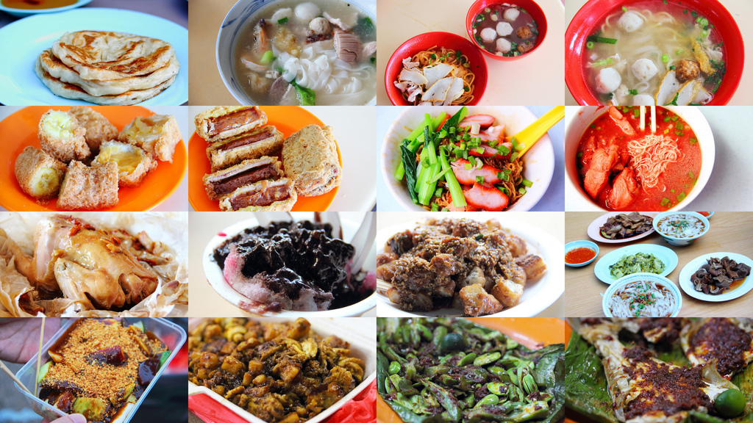
Background
Some of our strongest geographic and cultural
associations are tied to a region's local foods.
Challenge: Predict the category of a dish's cuisine given a list of its ingredients.

Slide 3
Background Cuisine Types

Slide 4
Background Top 5 Ingredients Table
Greek | Olive | Pepper | Fresh | Oil | Salt
Southern US | Salt | Pepper | Sugar | Butter | Flour
Filipino | Sauce | Pepper | Garlic | Salt | Oil
Indian | Ground | Salt | Oil | Onion | Seed
Jamaican | Pepper | Ground | Salt | Onion | Garlic
Spanish | Pepper | Oil | Olive | Salt | Garlic
Italian | Cheese | Pepper | Oil | Olive | Fresh
Mexican | Pepper | Onion | Salt | Ground | Garlic
Chinese | Sauce | Oil | Soy | Pepper | Garlic
British | Salt | Flour | Sugar | Egg | Butter
Thai | Sauce | Fresh | Oil | Lime | Garlic
Vietnamese | Sauce | Fresh | Pepper | Garlic | Sugar
Cajun Creole | Pepper | Onion | Salt | Garlic | Green
Brazilian | Pepper | Oil | Salt | Onion | Milk
French | Salt | Fresh | Pepper | Egg | Butter
Japanese | Sauce | Oil | Soy | Sugar | Salt
Irish | Salt | Flour | Butter | Sugar | Pepper
Korean | Sesame | Oil | Sauce | Onion | Garlic
Moroccan | Ground | Fresh | Pepper | Olive | Oil
Russian | Salt | Egg | Sugar | Flour | Pepper

Slide 5
Challenges Data cleaning
Importing and converting JSON data into a usable format in R
Purely text data analysis
Simplifying ingredient names
Lists inside of lists are not usable in tree
Created multiple databases
Used stemming to simplify ingredients
Example: low-fat milk and skim milk are both “milk”

Slide 6
Challenges Model Options
** Decision tree
If an ingredient falls in a Top 10 List, then it must be that cuisine type
Neglects less frequent cuisine types
Guess the most frequent cuisine type(s)
Use unique ingredients only
Italian, Mexican, and Southern US
Creates a baseline for all other models
Relies on accurate text analytics

Slide 7
Model 1 Baseline Model
Italian is most common type of cuisine.
Establish a baseline of accuracy by predicting Italian for all outcomes.
19.8% accuracy

Slide 8
Model 2 Decision Tree
Created a decision tree to predict cuisine type based on ingredients
Simplified ingredient names
42.8% Accuracy
Tree outputs 6/20 cuisines (66% occurrence)

Slide 9
Model 2 Decision Tree
YES
Tortilla
<0.5
NO
MEXICAN
Parmesan
>=0.5
ITALIAN
Soy
>=0.5
CHINESE
Cumin
<0.5
Olive
>=0.5
Ginger
>=0.5
ITALIAN
INDIAN
MEXICAN
Fish
<0.5
THAI
Cilantro
<0.5
SOUTHERN
MEXICAN

